Slide 1
Attention, Encoder-Decoder, Transformers
WKSP 420 Module 3, Lesson 2
Notes:
Now that we practiced some fundamental Natural Language Processing, let’s go into some more advanced methods. Here we will go into concepts of Attention, the Encoder-Decoder model and Transformers for NLP. Toward the end, we will also cover some concepts of Generative AI.

Slide 2
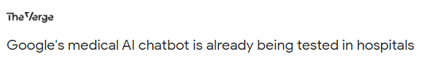
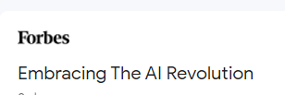
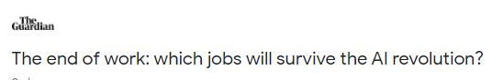
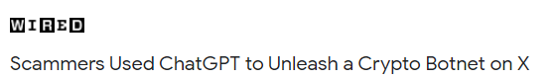
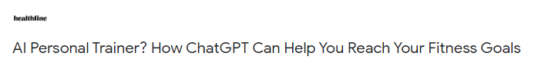
Transformers
Notes:
Since the 2017 paper on Transformers, and especially since the ChatGPT phenomenon in 2022 which really brought AI to the masses, there has been a ton of research and work in Transformers.
We see applications in medicine, impact on jobs, and also on scammers and malware. They can be used on text, images, even code. So let’s explore a little how they work and the fundamental concepts behind them. This will be helpful beyond this course because a lot of these concepts are being talked about in the ML community.

Slide 3
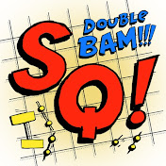
Transformer Fundamentals
Encoder – Decoder Model
Attention
Shout-out!
Notes:
There are 2 fundamental concepts that we need to cover a little to help in our understanding of Transformers, which are the Encoder-Decoder model and Attention.
A big shoutout to the YouTube channel StatQuest that covers these concepts in very satisfying detail while remaining easy to understand. I’ll post these videos in the notes of these slides and in canvas for optional viewing, though I highly recommend them.

Slide 4
Sequence to Sequence Translation
Let’s
Vamos
Translate
go
<EOS>
<EOS>
Notes:
Encoder-Decoder structure is mainly used for what is called “sequence to sequence translation”. This is where you’re converting one sequence of words into another. These sequences don’t need to be of the same length. The Encorder-Decoder structure divides the machine learning path into 2 pieces. The first piece called the Encoder which encodes the input words and the decoder which predicts the output words.
Each sentence on both input and output has an additional term called “EOS” for end of sentence. This tells the algorithm that it can stop generating new words.
Not shown here is that there is also a term called “SOS” or start of sentence which is sometimes used.
Youtube video reference: https://youtu.be/L8HKweZIOmg

Slide 5
Text
Tokenize
Embedding Layer
I
14
[1,2,3,4,5]
am
5
NN
[6,3,7,2,1]
Groot
1
[0,9,5,6,8]
Similar words should have similar embedding vectors
Notes:
Just a reminder that text strings are converted to numeric tokens. Then a simple neural network is used to determine word embeddings which are vectors of numbers. The neural network assigns the vectors in a way that words in your corpus that are similar to each other have similar vectors.
This is really important because without embeddings that follow this principal, all the other parts of the later algorithms would not work.
This a good reference on embeddings. https://youtu.be/viZrOnJclY0?si=OZ2js482rad0XyZw

Slide 6
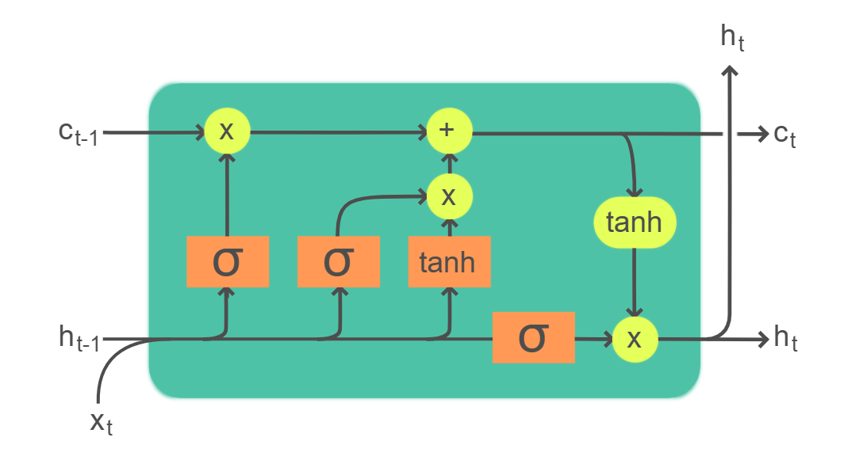
Encoder
Context
Hidden State
5 | 1
3 | 4
2 | 3
Embedding Layer
Let’s
Go
<EOS>
Input Layer
Notes:
This is an example of an encoder where we learn the input sequence and how words are related in that sequence. We learned about word embeddings. So for each word in your vocabulary, you will transform that to an unique number vector.
Shown here is that the encoder uses a series of LSTMs to process each individual word. Each word embedding is fed into the LSTM stages in a serial manner.

Slide 7
Encoder
5 | 1
3 | 4
2 | 3
Let’s
Go
<EOS>
2 | 3
Decoder
<SOS>
Notes:
The encoder then encodes all the input words sequentially and sends the context and hidden states from the last LSTM module to the first stage of the decoder, which is also a sequence of LSTMs.

Slide 8
Decoder - Training
SoftMax
Encoder
2 | 3
<SOS>
Notes:
Let’s simplify the picture a little. The first decoder LSTM stage will combine the 2 lines from the encoder and the seed SOS (start of sentence) word as input, and make a prediction. The output of the first LSTM stage is it’s prediction for the first word. The output is sent to a SoftMax function. Let’s go over the SoftMax function.

Slide 9

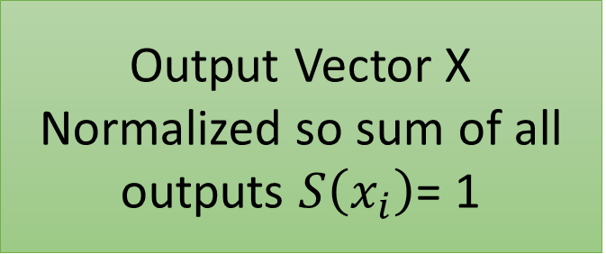
Softmax Function
25
50
10
15
0.25
0.50
0.10
0.15
$$Softmax\left(x_{i}\right)= \frac{exp⁡(x_{i})}{∑(\exp\left(x_{i}\right))}$$
Output Vector X
Normalized so sum of all outputs $S\left(x_{i}\right)$= 1
Input Vector X
S(X)
Softmax outputs a pseudo probability for each output
Notes:
The softmax function takes a vector of numbers and essentially scales them so that the sum of all of them add up to 1. So we see in this table that we have 4 numbers. After the softmax scaling, the transformed numbers all add up to 1. Because they all add to 1, then we can think of each softmax transformed number as a pseudo probability of that word.

Slide 10
Decoder - Training
Probability for each word in vocabulary
SoftMax
Encoder
2 | 3
<SOS>
Notes:
So when the decoder LSTM sends it’s hidden state to the softmax function, it’s sending a vector of numbers, where the length of the vector is the size of the vocabulary. Then the softmax function will output the probability for each word in your vocabulary.

Slide 11
Decoder - Training
1) Check to see if the output of the Softmax is the correct word.
2) If not, adjust the weights in backpropagation
3) Start next stage with correct next word from training data
???
SoftMax
Manzana
Encoder
3 | 4
2 | 3
Vamos
<SOS>
Notes:
While the softmax function makes a prediction of the next word in the sequence, during training, we know what the next word in the sequence should be. So we check the prediction to the actual, and then update the weights till they match.
Then in training, you provide the next word in the known target sequence to the next LSTM stage as input, and repeat the process.

Slide 12
Decoder - Test
1)Take Predicted word and feed as input in next stage
2) Stop when EOS is the next predicted word
<EOS>
SoftMax
Vamos
SoftMax
Encoder
3 | 4
2 | 3
<SOS>
Notes:
During Test, the procedure is slightly different. Imagine that you’re in the test phase. You don’t know what the target sequence should be. So the decoder will take the predicted first word and feed it as the input word to the next LSTM decoder stage. Keep going until the next predicted word is EOS for End of Sentence.

Slide 13
Encoder
5 | 1
3 | 4
2 | 3
Let’s
Go
<EOS>
3 | 4
2 | 3
Decoder
Vamos
<SOS>
Notes:
This is what the complete sequence looks like for our example. But we have just a few words in our sequence. Imagine if we had a large vocabulary with many complicated sentences. How would we pick out the right words if our vocabulary had thousands of words?

Slide 14
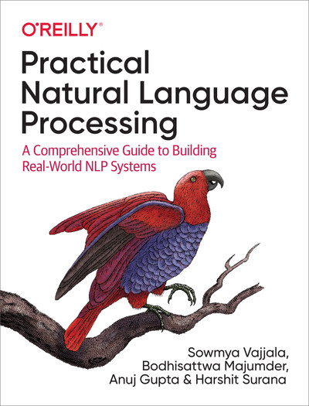
Attention
Find the definition of “Relationship Extraction”
Notes:
What if I gave you a book and asked you to find the definition of a term, say “relationship extraction”. Well this is where inspiration from human beings comes in handy.

Slide 15
Attention
Memorize the whole book, then extract definition
Find the definition of “Relationship Extraction”
Go to RE Section and find definition there
Notes:
Well, you could read the book cover to cover and memorize every word perfectly. Then you would know the definition because it’s part of what you memorized.
But this is frankly impossible for humans, and it turns out it’s also impossible for machine learning algorithms.
Instead, we humans would go to the section on relationship extraction and then we would focus on the sentence that contains it’s definition. We are directing our attention to the relevant part of the book.

Slide 16

Notes:
Similarly, if you create an algorithm to generate a caption, you want the attention to go to the main parts of the picture.

Slide 17

Notes:
So you want to focus on the girl and the frisbee, not the grass that makes up the majority of this picture.
This is described in the paper Show, Attend and Tell: Neural Image Caption Generation with Visual Attention which I will include in Canvas for reference.

Slide 18
LSTMs start to forget beginning words as text grows longer
Don’t take magic beans in exchange for your only cow
Don’t take magic beans in exchange for your only cow
Notes:
When using RNNs or even LSTMs with their long term memory, it is often not sufficient to remember every word in the text. The output of a long LSTM sequence encodes all of the words in the text into that one output. Often when we do this, there is less and less emphasis placed on the beginning words. This can be a problem. For example, in the sentence here, the word “Don’t” is very important to the meaning of the whole sentence.
By using the attention mechanism to highlight which words to focus on, we can essentially deal with very large text because you can blur out the correct words that are not helpful and focus on the ones that are most beneficial.

Slide 19
The Problem – Context!
Encoder
All of the input words are accumulated in this last Context and Hidden lines
Decoder
Notes:
A classic problem of RNNs and even LSTMs is that when you combine too many stages, the earlier words in a sequences tend to get de-emphasized. But you’re never sure where the most important word in the sentence will be, so you can’t afford to let the algorithm ignore the earlier words.

Slide 20
The Solution – Attention!
Encoder
<SOS>
Let’s
go
<EOS>
Similarity Measure
Vamos
<SOS>
Decoder
Notes:
So as a solution, we use something called Attention. In this method, the hidden states of all the words from the encoder are now used with the output of the first hidden state of the decoder. Why only the hidden state? Because in an LSTM the hidden state incorporates the short term memory which is what we are trying to send.
The output of the Decoder first stage is the first predicted word. Use a similarity measure to see how similar each input word is to the first predicted word from the decoder.

Slide 21
Decoder Attention
Encoder Input | Encoder Output (hidden state only) | Similarity Score Vamos (Decoder) | Softmax Score | Softmax Score * Encoder outputs
<SOS> (Encoder) | 1 | -0.6 | 0.04 | 0.04
Let’s | 2 | 0.2 | 0.3 | 0.6
Go | 3 | 0.5 | 0.6 | 1.8
<EOS> (Encoder) | 4 | -0.3 | 0.06 | 0.24
Attention
2.68
Similarity scores tell the decoder what percentage of each input word should be used by the decoder to predict the next output word
Notes:
After calculating the similarity score, it’s fed through a softmax function to get percentages for each word. This output tells the decoder what percentage of each input word should be used in predicting the next output word of the sequence.
Then combine all of the softmax scores to get a single attention value for the output of the first decoder prediction. If you want to know how the softmax scores are combined, see the reference video I’ve provided on Attention from the StatQuest YouTube channel.

Slide 22
Attention Value
(2.68)
Fully Connected Layer
Decoder LSTM Output
Softmax
Final Prediction!
Notes:
So now that we have the attention value for the first decoder stage, we send that and also the direct output of the first decoder stage to a fully connected neural network layer. Then this will make a final prediction for the first word of the decoder sequence.

Slide 23
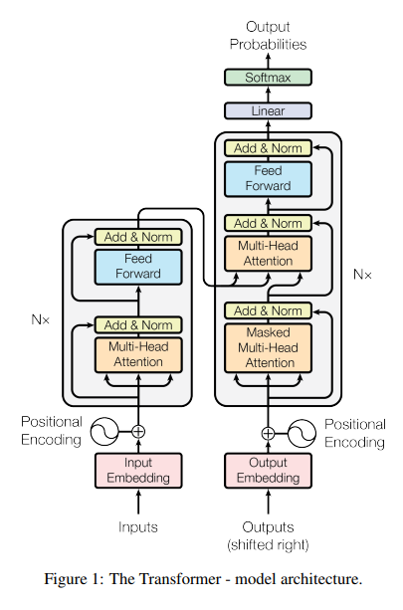
Transformers
Notes:
Now that we’ve learned about a few fundamental building blocks, namely the Encoder-Decoder model and Attention, we can tackle Transformers. This is a very complex algorithm and I will not be covering it in full detail. I have put a youtube video from StatQuest that describes in very nice detail that is also easy to follow.
Transformers were first described by a paper from Google researchers named “Attention is All You Need”. It is a very dense paper to study without going through some tutorials first. I will post the paper in Canvas for reference.

Slide 24
Encoder
Decoder
Notes:
You’ll see the overall structure follows the encoder-decoder model. However, there is a difference in the fundamental way in which words are processed by both stages.

Slide 25
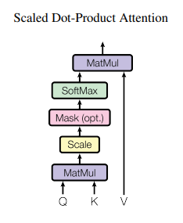
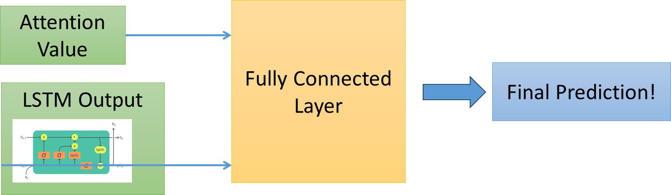
Attention Units
Notes:
First off, RNNs and LSTMs have been removed altogether and replaced entirely with attention units.
Remember that we just learned that attention is generated from the outputs of the LSTMs in the encoder and is used with the decoder LSTMs to generate a word prediction.
Well in transformers LSTMs are removed and all of the prediction is done with attention units. One advantage here is that LSTMs and RNNs are sequential in nature and make training in parallel with GPUs and large computing clusters difficult. The transformer units on the other had are perfect for training in parallel and can really get a speed boost.
Another thing to note is that there are new values that are generated in this attention unit. Namely these are the Query, Key and Value and these are calculated for each word.

Slide 26
Transformer Input – Positional Encoding
Word Encoding
Positional Encoding
Lets
Go
0.3 | -0.4
1.1 | -0.9
0 | -0.3
0.8 | 0.2
0.3 | -0.7
1.9 | -0.7
Combined Encoding
Notes:
Let’s step back even further and go to the input. When we were using RNNs and LSTMs, there was an implicit way to remember the position of each word. This is because the LSTMs were in series and each word arrived in series. So the first word arrived at the first LSTM stage, then the second arrived to the 2nd stage, and so on.
But if we’re removing LSTMs and replacing them with only attention units, we’ve now lost the positions of the words. Transformers compensate for this by adding an additional encoding to the word encodings that we’ve used before. Remember that word encoding is a unique vector of numbers that represents the string word. Then positional encoding is a way to describe in a vector of numbers where the word is located in the sentence or paragraph in the input text.
These 2 encodings are added together to give the combined encoding which goes into the Transformer. USAF relevancy: One thing that I’ve come across recently was discussion on if the input text that the transformer was trained on was classified, are these combined encodings also classified? I think that’s probably a yes, because the encoding algorithm is not the same as encryption and can probably be reverse engineered to plaintext provided enough observations.

Slide 27
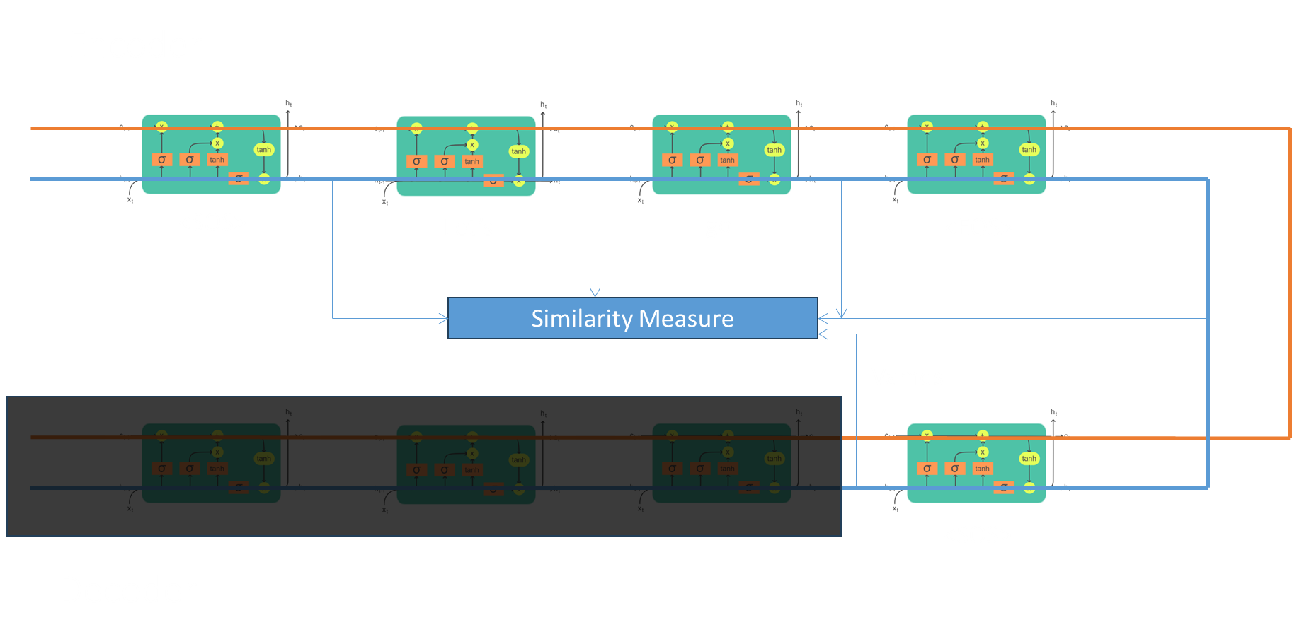
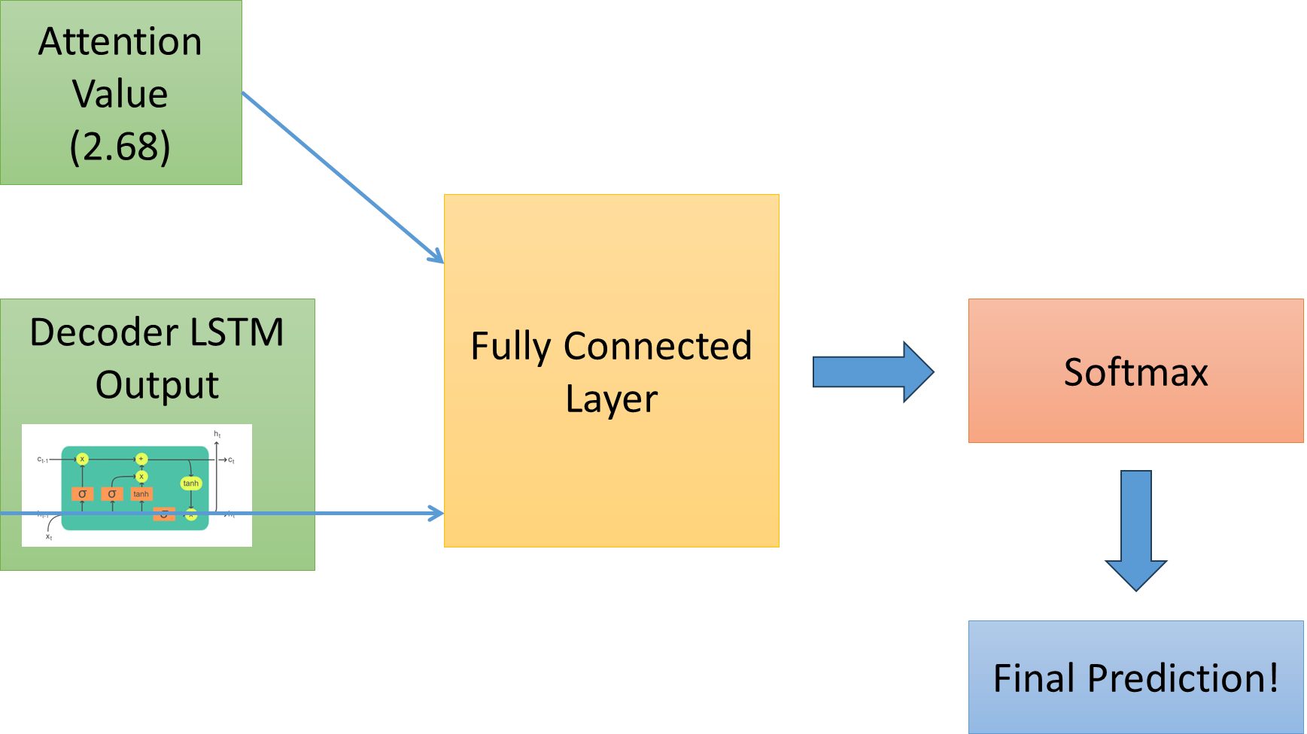
Background: Attention
Notes:
Let’s get into the Query, Key, Value part of the transformer. Remember this is how we learned Attention is generated in the classical Encoder-Decoder model.
You send the hidden state of each word in the encoder and compare it to the first predicted word from the decoder. Then you combine the attention and the decoder prediction to get your final predicted value.
The Query, Key, Value model does something similar.

Slide 28
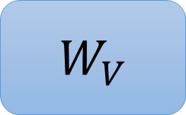
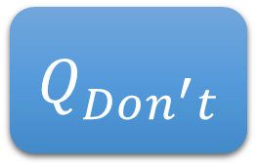
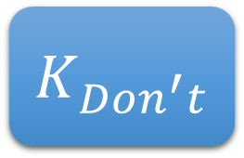
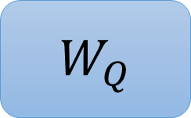
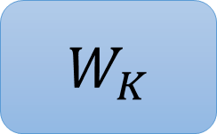
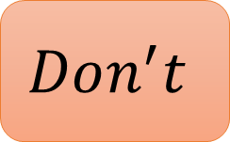
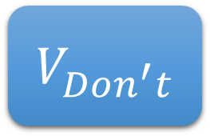
Query, Key, Values
Don’t take magic beans in exchange for your only cow
$W_{Q}$
$Q_{Don^{′}t}$
$$Don^{′}t$$
Positional + Word Encoding
$W_{K}$
$K_{Don^{′}t}$
$W_{V}$
$V_{Don^{′}t}$
Learning
Notes:
Self attention works by generating a Query, Key and Value for each word on your encoder sentence.
So say we have this sentence, and we want to calculate how much attention to give the words related to the word Don’t. Because we’re calculating attention between words in the encoder only, we call this “Self Attention”.
You generate Key, Query and Value for each word in your encoder by taking their encoding values, assigning weights, and then taking the weighted output. In the beginning, these weights are random. As you train your transformer, these weights adjust to fit the expected output.

Slide 29



Query, Key, Values
Don’t take magic beans in exchange for your only cow
$Q_{Don^{′}t}$
$$Q_{take}$$
$$Q_{magic}$$
$$Q_{beans}$$
$K_{Don^{′}t}$
$$K_{take}$$
$$K_{magic}$$
$$K_{beans}$$
$V_{Don^{′}t}$
$$V_{take}$$
$$V_{magic}$$
$$V_{beans}$$
Notes:
Let’s start with the word Don’t. These are the key, query and values generated for all the words in our dictionary.

Slide 30
Query, Key, Values
Don’t take magic beans in exchange for your only cow
$Q_{Don^{′}t}$
$$Q_{take}$$
$$Q_{magic}$$
$$Q_{beans}$$
$K_{Don^{′}t}$
$$K_{take}$$
$$K_{magic}$$
$$K_{beans}$$
$V_{Don^{′}t}$
$$V_{take}$$
$$V_{magic}$$
$$V_{beans}$$
Dot Product
Notes:
You’ll determine how important each word in the encoder is to the word Don’t, including itself. This is similar to what we saw when we were generating Attention with the LSTMs. I’ve put words that are more important as being connected with a thicker line. Now, you might be asking how does the encoder know which words are more related to each other? That answer comes from the embedding layer. Remember that in the Embedding layer, we ingest all of the words of the training set and a Neural Network layer finds words that are related to each other and converts them into vectors that are similar. That similarity relationship is what we use here when determining which Query word is most related to which Key word. Since we have the vectors, we can use the dot product between them to calculate their similarity.

Slide 31
Query, Key, Values
Don’t take magic beans in exchange for your only cow
(SoftMax)
$Q_{Don^{′}t}$
$$Q_{take}$$
$$Q_{magic}$$
$$Q_{beans}$$
$K_{Don^{′}t}$
$$K_{take}$$
$$K_{magic}$$
$$K_{beans}$$
$V_{Don^{′}t}$
$$V_{take}$$
$$V_{magic}$$
$$V_{beans}$$
40%
30%
10%
20%
Dot Product
Multiply
Notes:
Once you’ve determined how important each word is to Don’t, or how much attention to pay to each word for the word Don’t, you’ll multiply those with percentages the Values for each word. So the Value for the word Don’t will be scaled by 40%, the Value for the word Beans will be scaled by 20%, etc. In this way we get scaled attention values for the word Don’t to every other word.

Slide 32
Query, Key, Values
Don’t take magic beans in exchange for your only cow
(SoftMax)
$Q_{Don^{′}t}$
$$Q_{take}$$
$$Q_{magic}$$
$$Q_{beans}$$
$K_{Don^{′}t}$
$$K_{take}$$
$$K_{magic}$$
$$K_{beans}$$
$V_{Don^{′}t}$
$$V_{take}$$
$$V_{magic}$$
$$V_{beans}$$
40%
Sum = Self Attention value of “Don’t”
30%
10%
20%
Dot Product
Multiply
Notes:
Then you’ll add all those together to get the final self attention values for the word Don’t. The reason we do this is that the self attention value of the word Don’t contains now context of all the other words in our sequence. Whew! Also know that there is one more layer called a residual connection that I’m not covering that comes after the self attention layer.

Slide 33
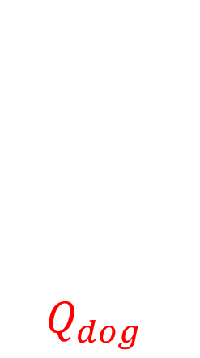
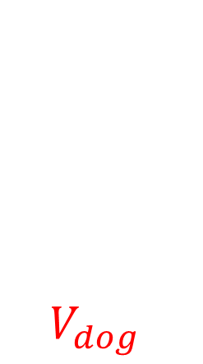
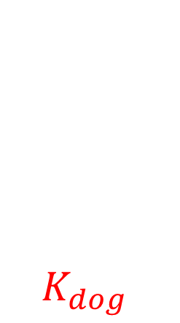
Query, Key, Values
Don’t take magic beans in exchange for your only cow
(SoftMax)
$Q_{Don^{′}t}$
$$Q_{take}$$
$$Q_{magic}$$
$$Q_{beans}$$
$$Q_{dog}$$
$K_{Don^{′}t}$
$$K_{take}$$
$$K_{magic}$$
$$K_{beans}$$
$$K_{dog}$$
$V_{Don^{′}t}$
$$V_{take}$$
$$V_{magic}$$
$$V_{beans}$$
$$V_{dog}$$
38%
Sum = Self Attention value of “Don’t”
28%
8%
18%
8%
Dot Product
Multiply
Notes:
One thing I want to point out is if we have a new word, we can reuse most of the prior calculations. Shown in Red are the areas that would need to be calculated.
In the lab, we’ll see how to tune our model to work for a custom dataset of vocabulary. This updating in red is what’s going on behind the scenes when we do that.

Slide 34



Multi-Headed Attention
Notes:
The original transformer paper talks about Multi-headed attention. This is simply using more than one of the self-attention unit so that the encoder can learn different kinds of relationships between words, sentences and paragraphs.

Slide 35
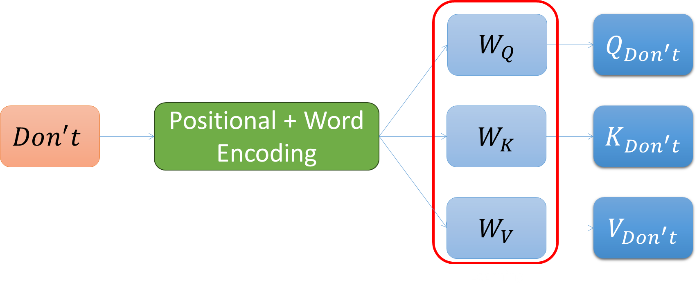
Some Interesting Points
Weights
The weights for Q, K, V are the same for every word!
Once weights are calculated, we reuse them for every input word
Parallelization
Can calculate Q, K, V for each word at the same time
Key difference between LSTMs and Transformers
Advantage for GPUs, Supercomputers
Notes:
There are some key insights for practical purposes for the transformers.
The first is that the weights for the Queries, Keys and Values, once learned on one word, remain the same for every word.
So even though the transformer is much more complicated and has many more steps than an RNN or LSTM network, we are only calculating a single set of weights once.
The 2nd point is parallelization. We don’t have to calculate the Queries, Keys and Values for the first word first, then calculate them for the 2nd input word, and so on a serialized manner. We can calculate these for all of the words at the same time. This is huge, because now these metrics can be calculated in parallel for all the words in your input. That’s why there is so much hype around GPUs and super-computing when it comes to training these transformers. You really get a big boost, whereas you couldn’t do that with serial networks such as RNNs and LSTM encoder-decoder models.

Slide 36
Encoder Block
Self Attention
Q,V,K Generation
May be Multi-Headed
Position + Word Encoding
Embedding
Word
Notes:
Let’s next move from the Encoder to the Decoder. I’m shrinking the encoder block to be represented this way. This will save me screen real estate for later.
So we have all the different layers, the word, embedding and self-attention where the Query, Key and Values are used.

Slide 37
Decoder Block
Self Attention
Q,V,K Generation
May be Multi-Headed
Embedding
Translated Words
(Target Words)
Word
Notes:
In the decoder block, the self-attention cell is largely the same. So the decoder will be having to generate it’s own self-attention, with it’s own Queries, Keys, and Values that we went over with the Encoder previously, just now we’re doing it for the target words.
For a language translation algorithm, these might be the translated words that we are trying to predict correctly.

Slide 38
Encoder-Decoder Attention
Encoder
<SOS>
Let’s
go
<EOS>
Similarity Measure
Vamos
<SOS>
Decoder
Notes:
Now to connect the Encoder and Decoder, let’s go back to Attention which we covered at the beginning of this lesson. This was where words in the encoder were compared to words in the decoder to see where to focus our attention. Something similar needs to be done with the Transformer.

Slide 39
Encoder-Decoder Attention
Don’t take magic beans in exchange for your only cow
No tomes frijoles mágicos a cambio de tu única vaca
Notes:
When you do language translation, you often need to translate words in a different order than the original language. For example in this case, the order of magic and beans is flipped when translating to Spanish.
The transformer decoder needs to pay greater attention when predicting the word “magicos” to the input word “magic” and not “beans”.

Slide 40
Encoder-Decoder Attention
Let’s
Less weight
Vamos
Go
More weight
Notes:
Similarly in our very short vocabulary example, the decoder needs to pay more attention to the word “Go” when predicting “Vamos” than to “let’s”.

Slide 41
Self Attention
Self Attention
Embedding
Embedding
Word
Word
Encoder
Lets
Go
<SOS>
Decoder
Notes:
We created Self-Attention by generating Query, Key and Values in the Encoder and Decoder independently.

Slide 42
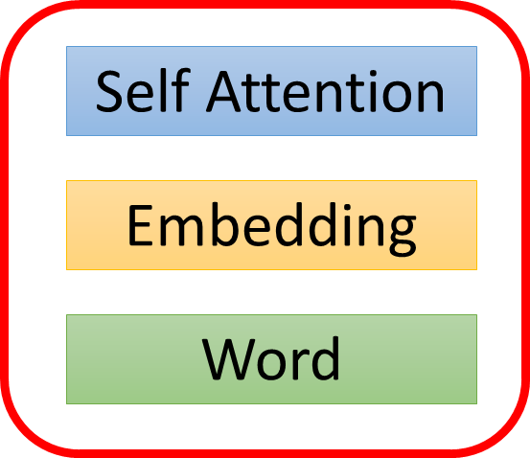



Encoder-Decoder Attention
$$K_{Lets},K_{Go}$$
$$Q_{Vamos}$$
$$V_{Lets}, V_{Go}$$
Self Attention
Embedding
Word
Encoder
Lets
Go
<SOS>
Decoder
Notes:
Now we need to generate the Encoder-Decoder Attention jointly so that the translated word focuses on the correct original language word. So we do this by generating Queries from the Decoder on the translated words, and Keys and Values for each input word in the Encoder.
Then similarly to what we did for the self attention values, the Query for the word Vamos at the decoder will be compared to the Keys for the words Let’s and Go at the Encoder, and then Values will be generated for each.

Slide 43
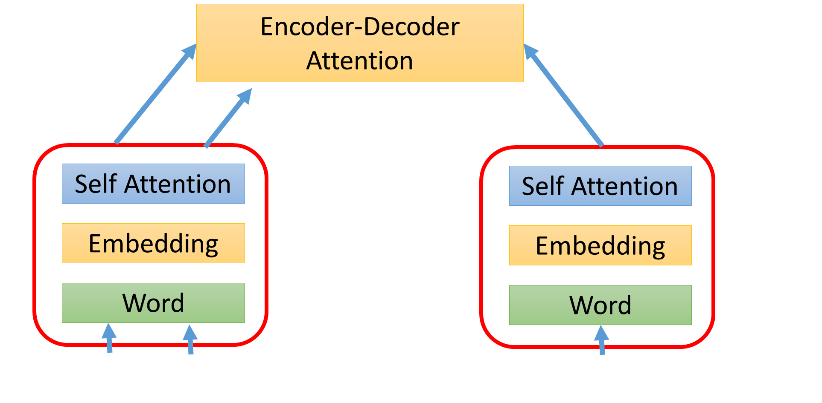



Query, Key, Values
(SoftMax)
$Q_{Vamos}$
$K_{Let^{′}s}$
$$K_{go}$$
$V_{Let^{′}s}$
$$V_{go}$$
70%
Sum = Encoder-Decoder Attention value of “Vamos”
30%
Dot Product
Multiply
Notes:
So this is what I mean. The Query for Vamos at the decoder is generated. And the Key for Let’s and Go is generated on the Encoder side. So we will compare the Query for Vamos to the Keys for Let’s and Go, and then get the attention values based on what encoded word is most related to Vamos. Then those percentages will be used to calculate the Values at the encoder for each word. We’ll sum those and then that will be the final attention value for the encoder-decoder combo.

Slide 44
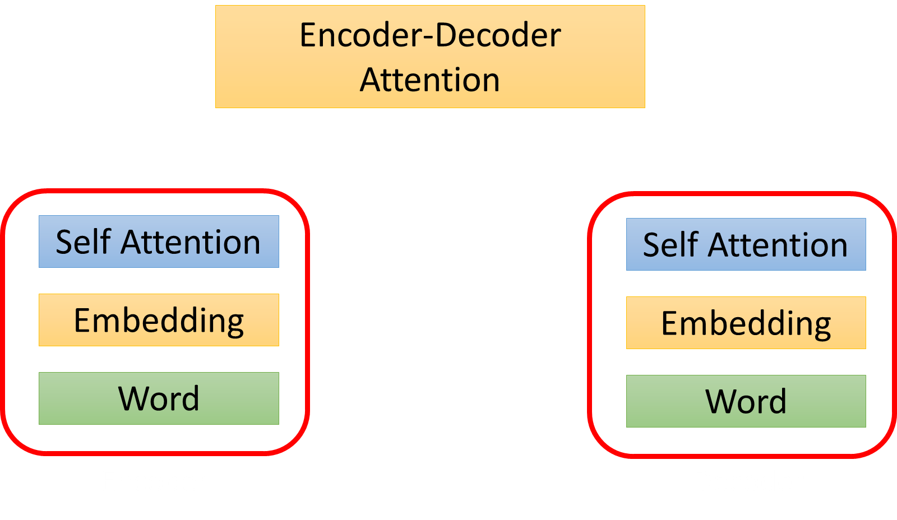
Fully Connected Layer
Final Prediction!
Notes:
Now for the final step, we send the decoder’s prediction, and the encoder-decoder self attention values to a fully connected layer, and then the output of that will be the final predicted word. The reason we do this is so that we combine the prediction of the word based on self attention from the decoder, and the prediction of the word based on the encoder-decoder attention and combined we get a stronger final prediction.

Slide 45
Fully Connected Layer
Final Prediction!
SOS | Vamos | EOS
0.1 | 0.7 | 0.2
Notes:
Now for the final step, we send the decoder’s prediction, and the encoder-decoder self attention values to a fully connected layer, and then the output of that will be the final predicted word. The reason we do this is so that we combine the prediction of the word based on self attention from the decoder, and the prediction of the word based on the encoder-decoder attention and combined we get a stronger final prediction.

Slide 46
What’s Not Covered
More detail on:
Masked Decoder Attention
Queries, Keys, Values generation
Word embeddings
Positional Encoding
Multi-Headed Attention
Notes:
So that was a lot and what I covered is just enough to give you a fundamental understanding of transformers. It’s enough to show you why they are advantageous and popular along with some of the downsides.
There is also a lot that I haven’t covered for transformers. I’m not going into detail on
- how the self-attention in the decoder is slightly different than the Encoder, in that certain values are masked
- how the Keys, Values and Queries are generated – that is, I didn’t cover how the weights are tuned.
- how word embeddings are generated. I kind of just said that a neural network takes care of that.
- the math behind positional encoding
- and how multi-headed attention works.
If you wish to explore the topics more, I highly encourage you to watch the extra videos on the Canvas page.

Slide 47




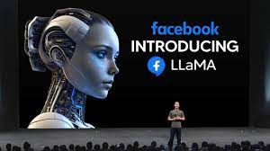
How to Use a Transformer
Transformers are pre-trained models
Tune to your text dataset
Notes:
In a practical sense, you will generally not create your own transformer. You will most likely use a pre-trained model. I remember in 2019 going to an Nvidia conference and hearing about transformers for the first time and how the researchers were able to tune the Bart model so that even though it was originally trained in English, it could be used to translate German. I thought I had heard that wrong.
There are many commercial and open source repositories of transformers. Huggingface is an opensource repository and we’ll cover how to use transformers from this repository in the lab. I’ll also show you how to tune the model to fit your specific text data.

Slide 48
Carbon Emission
Notes:
One of the main downsides of transformers is that they are extremely complex and require very large amounts of power and time to train, even though they are highly parallelizable.
You can see that compared to the average US household, GPT3 takes many orders of magnitude more power and CO2 emissions.
Transformer proponents say that they offset these emissions by needing much less power to use these models than train them. Because they are general purpose and can be used by many users, since each user is not having to train their own model, in the long run the public ends up saving energy. But these models are constantly being updated so that assertion is questionable.

Slide 49
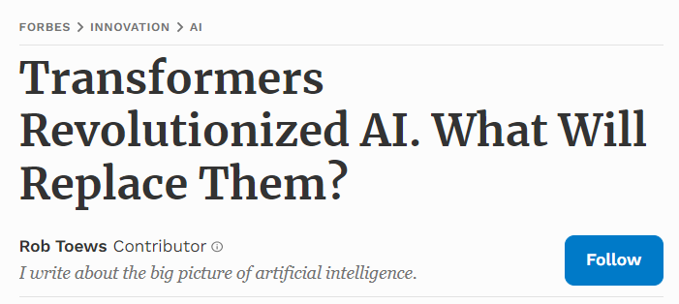
Beyond Transformers?
Transformer scales quadratically with sequence length
Hyena: Attention Free architecture
Liquid NNs – Probabilistic weights
Notes:
(For canvas: Interesting: How reinforcement learning teaches ChatGPT4 how to tell a joke that people will find funny. https://youtu.be/WMmGzx-jWvs?si=v-1tZIIZDWLNh82w)
Since every word in the sequence is compared to every other word, the transformer complexity grows quadratically with the length of the sequence. If you want a transformer that can read entire documents, you have an extremely large algorithm.
Included in this article are references to several challengers to improve on Transformers. Each of these papers are included in Canvas for reference.
Hyena uses element-wise multiplication and long convolution in a solution that scales better than transformers without using attention. Researchers are currently using it to see if they can scale it to fit a token as large as the human DNA, which is 3.2 Billion in size
Another architecture proposed is Liquid Neural Networks where the weights are not static, but probabilistic in nature. This gives many different options for weights, and thus reduces the number of parameters greatly. In one application, they were able to train a self-driving car algorithm with 19 neurons and 253 parameters. This helps a lot not just on computational resources, but makes the algorithm easier to understand to a human.

Slide 50
Generative Adversarial Networks (GANs)
Generator Loss
Generator
Discriminator
Real Images
Discriminator Loss
Notes:
Let’s talk a little bit about other types of Generative AI. Image generation typically happens through Generative Adversarial Networks. These consist of 2 parts that work together in a loop. The Generator generates what it thinks is the desired image. The Discriminator takes that and the real image and learns how to spot the fake. The losses from one training cycle are used to tune both the discriminator and the generator.
Over time, each gets better but it becomes harder and harder for the discriminator to spot the fake. When the discriminator can no longer spot the fake to a certain degree of accuracy, the fake image is determined to be “ready”.

Slide 51


Open Source Tools
Prompt = “Dog playing with boy”
Notes:
There are many GAN tools out there. They are not always successful. Dall-E is an image generating algorithm that takes in text that a user enters and outputs it’s estimate of the desired picture. In this image, we see that the boy is not correctly generated. This was created by a free website called Craiyon. I don’t know the underlying algorithm that this website is using.

Slide 52
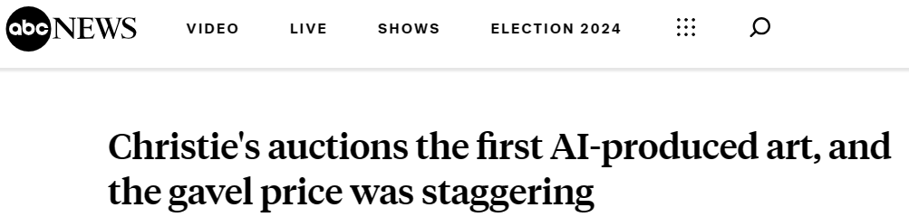
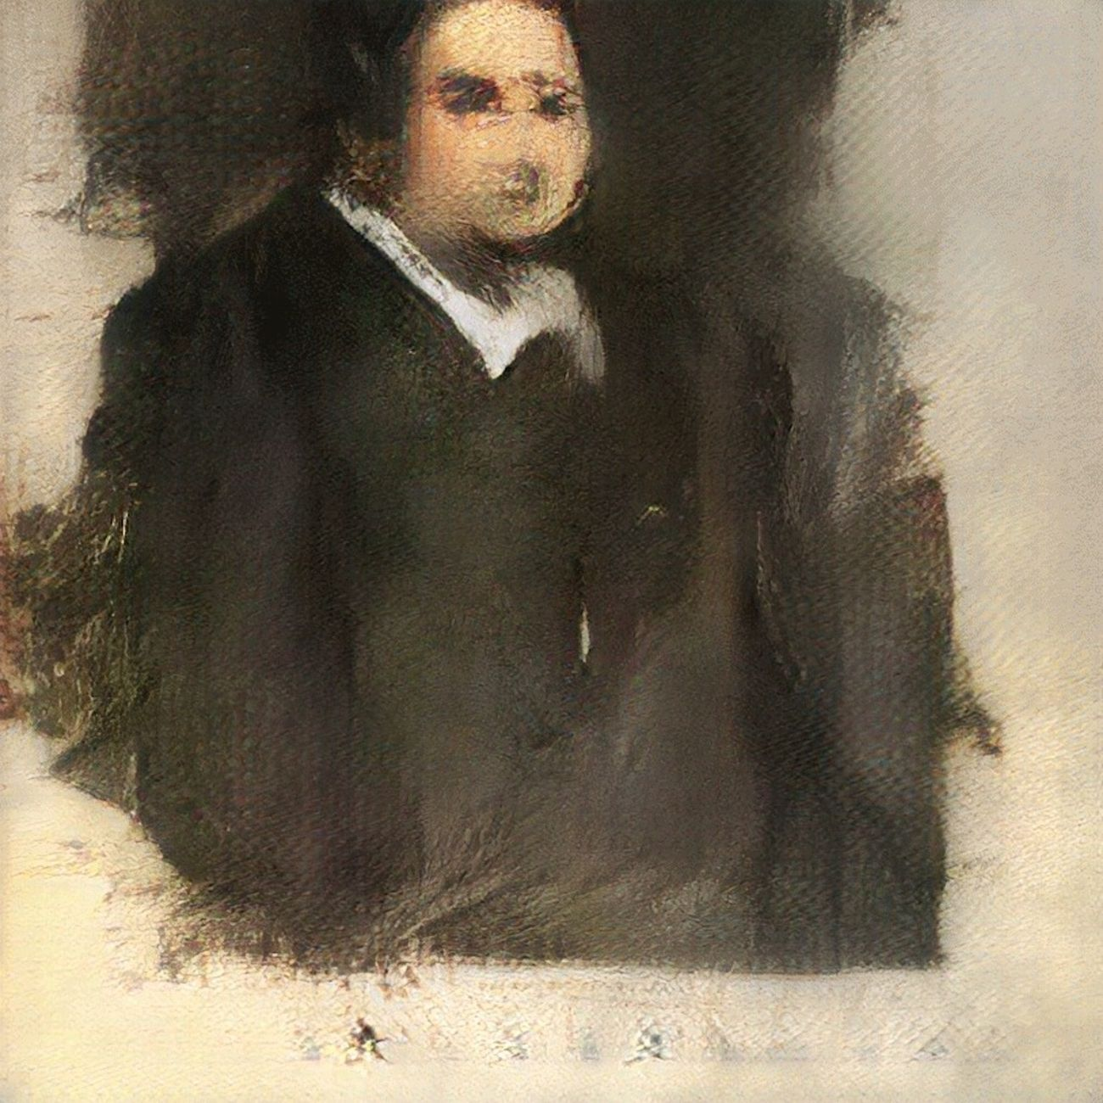
Notes:
However, they are constantly getting better. This image in 2023 is the current record holder for the highest paid AI generated art. Now all art is subjective, so I’m not asking that you agree with the price tag for this painting, but know that this area is in a constant state of upgrade.

Slide 53
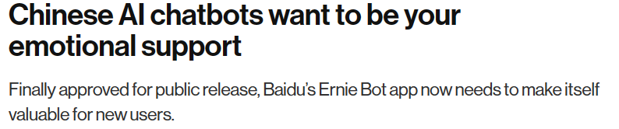
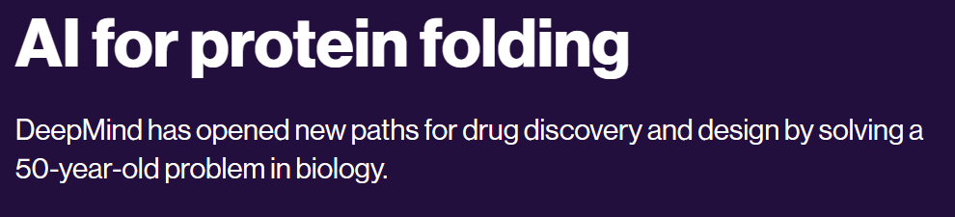
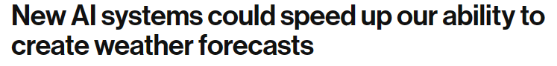
Generative AI Uses
Source: MIT Technology Review
Notes:
Researchers and companies are finding many different uses for generative AI models and machine learning in general. Already there has been progress in finding new medicines, better forecasting models. Chatbots have been created for customer support and are starting to be explored for emotional support.

Slide 54
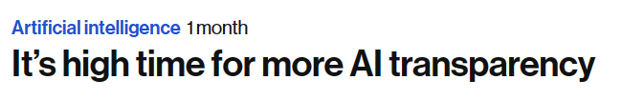
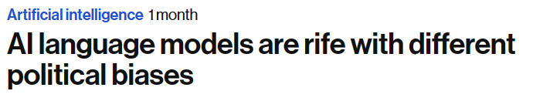
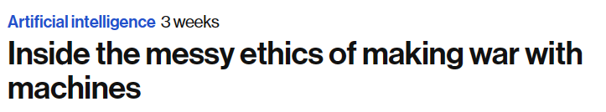
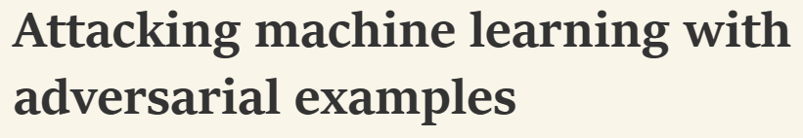
Vector Check?
Source: MIT Technology Review and OpenAI
Notes:
I bet while you were reviewing the previous slides that some ethical questions came to mind. Most commercially deployed AI models are hopelessly complex and impossible to understand why they choose a particular answer. There are many paths to introduce biases in their training, and also there is a large body of research being done on how to fool AI models. With all that being said, we need to follow a disciplined approach to building and deploying AI models, especially with respect to the how we conduct our business in the Department of Defense.

Slide 55



DAF Guidance
Notes:
As Airmen and Guardians start using Large Language Models in their personal lives, we need to be aware that caution must be used for official business. This June 2023 memo states that LLMs as of now are not approved for CUI in their current commercial forms. There are some experimental LLMs on government approved systems that are being tested, but make sure you check with your security office before feeding any LLM your CUI or official text as input.

Slide 56

Notes:
There’s also a field guide for prompt engineering with guidance on how to generate prompts to get the best output. Also included in this is guidance on how to prevent biased outputs from these models. This is of course personal or experimental use.
At this point, it is important to further understand how Bias can affect AI models and how the DOD instructs us to use AI models in an ethical manner.
We’ll learn more about that in our next module on Ethics and Bias in AI models.

